Slide 1
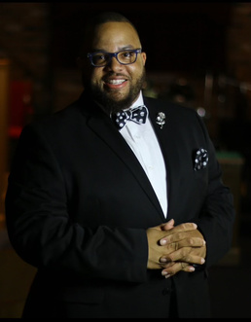



HUGO J. MORRISON
SR. FAMILY SERVICE COORDINATOR
CONTACT
PROFILE
+757-582-8029
I have extensive experience in organizational leadership, strategic planning, program development, case management, facility management, and family resiliency. I am confident that my expertise will be valuable in any professional setting where I can offer human services. My experience includes providing intensive in-home counseling and case management to youth and their families, developing individualized service plans, and maintaining up-to-date client records. I am committed to continuous learning and improvement to stay up-to-date with the latest practices and techniques in the field.
hugo.morrison@hampton.gov
1914 Lansing Ave. Portsmouth, VA, 23704
EDUCATION
WORK EXPERIENCE
2000-2004
City of Hampton
2022 - PRESENT
OLD DOMINION UNIVERSITY
Senior Family Services Coordinator
  Bachelor of Science in Communications Minor in Psychology
  As a key member of the city's violence reduction team, the coordinator's role involves assessing social backgrounds and violence incidents for intervention opportunities. They provide guidance on service plans, lead case reviews, collaborate with partner organizations, conduct research for program development, manage outreach specialists, and oversee the city's summer youth employment program.
2006 - 2009
REGENT UNIVERSITY
City of Hampton
2018 - 2022
  Master of Divinity degree with a focus on Practical Theology
Hampton Arts Education Manager
2010 - 2011
  Managed arts education programs and the vision of the Hampton Arts Commission, handled budgeting, and negotiated staff contracts for high-quality arts activities while serving as a liaison to various councils, commissions, and community groups.
NORTH CAROLINA STATE UNIVERSITY
  Management Certificate
City of Hampton
2016- 2018
SKILLS
Performing and Creative Arts Manager
  Project Management
  Public Relations
  Teamwork
  Time Management
  Leadership
  Effective Communication
  Critical Thinking
  Managed the Performing & Creative Arts Center, overseeing staff and vendors, and creating innovative programs for youth in alignment with the city's artistic vision. This included thematic programming and organizing special events.
REFERENCE
Imara G. Diaz
Steven D. Bond
City of Hampton, Director
City of Hampton, Judge
Phone:
757-506-1027
Phone:
757-719-3198
Email :
imara.diaz@hampton.gov
Email :
sbond@hampton.gov

